Slide 1
Q&A Session: Connecting Office of Research & Evaluation Research Grantees with AmeriCorps NCCC and VISTA Programs June 18, 2019

Slide 2
Introductory Remarks Connecting ORE Research Grantees with AmeriCorps NCCC and VISTA Programs
Dr. Andrea Robles Research and Evaluation Manager, Office of Research and Evaluation, CNCS
arobles@cns.gov

Slide 3
AmeriCorps NCCC
Amanda Cochran
Tanya Gipson-Nahman

Slide 4
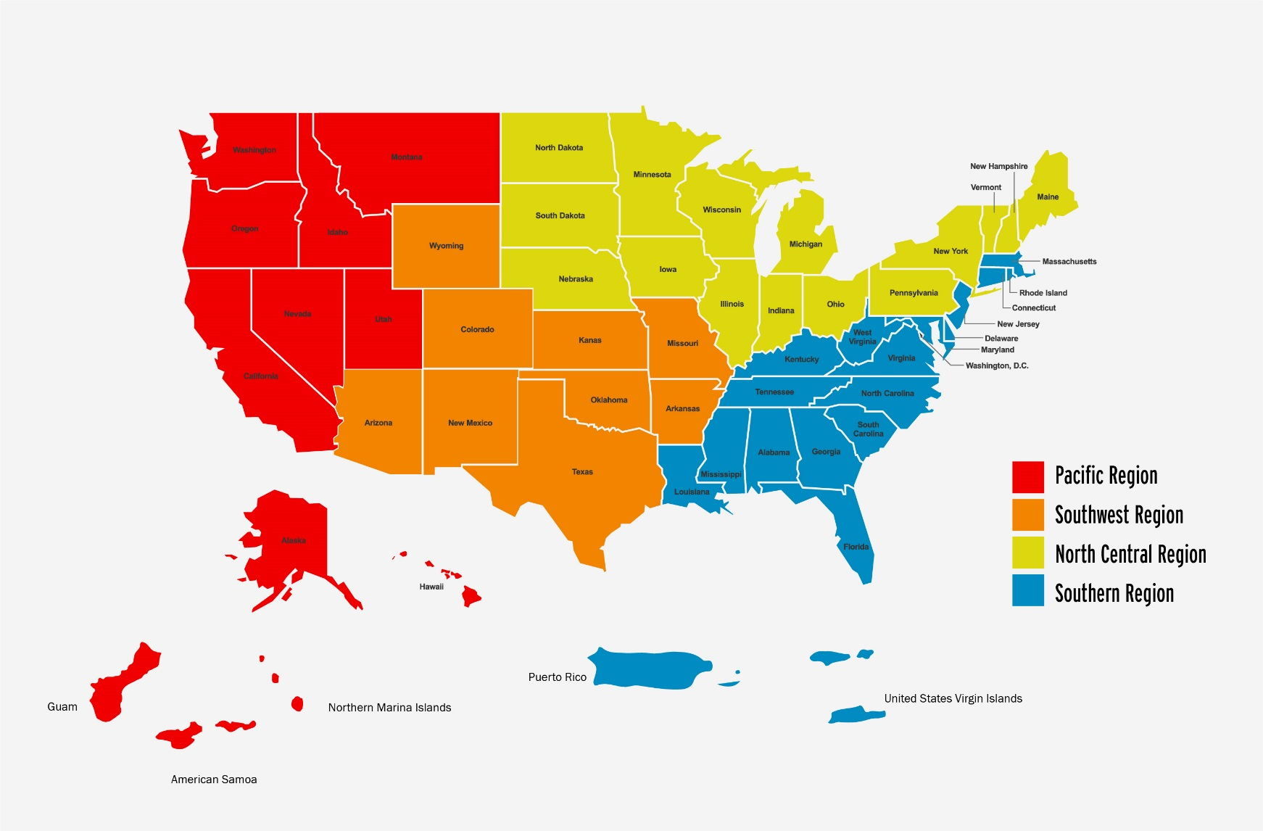
AmeriCorps NCCC Structure

Slide 5
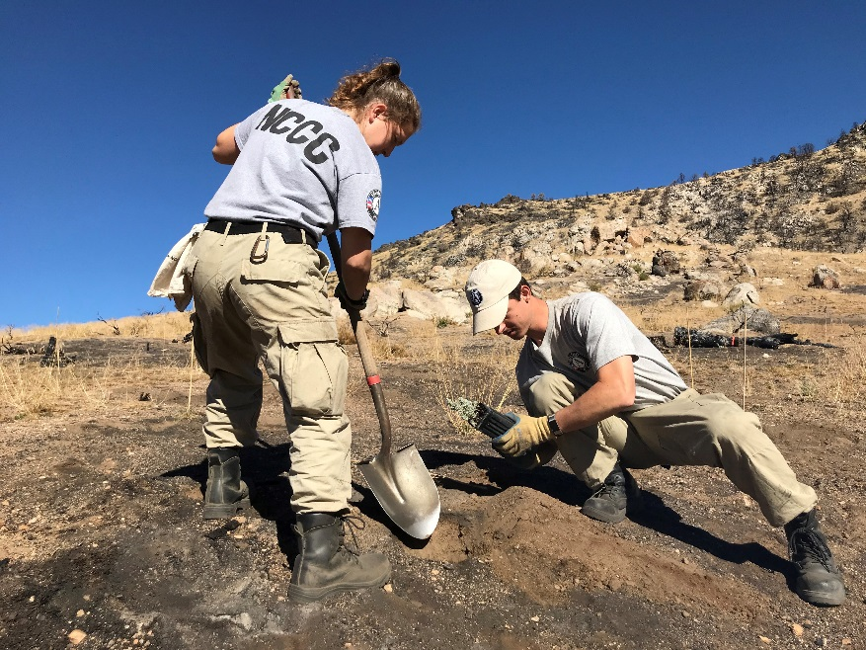
AmeriCorps NCCC
Direct service: Extra people power!
Team based: 8-12 members, 18-24 years old
Short term: 6-12 week projects
Areas of Service
Natural and Other Disasters
Environmental Stewardship and Conservation
Energy Conservation
Infrastructure Improvement
Urban and Rural Development

Slide 6
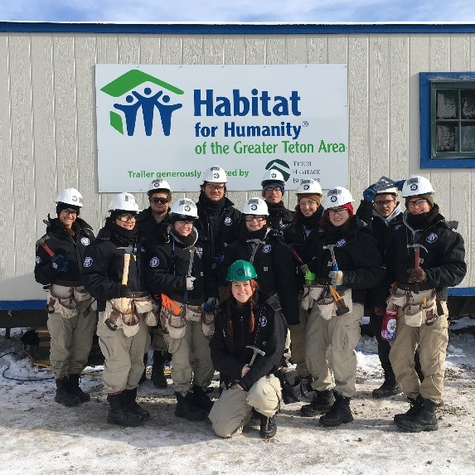
Project Sponsors
Who can apply for a team?
Nonprofits
Faith-Based Organizations
Government (federal, state, and local)
Public schools, colleges and universities
Tribal Councils and Native Corporations
How do I apply for a team?
Coordinate with your region’s Program Office staff to develop a project
Submit a Project Concept Form as the first step, based on the timeline provided by the campus
The campus will then provide you with the full application to complete

Slide 7
Teams Are Provided With
AmeriCorps NCCC Provides:
15-Passenger Van
Food & laundry budget
Camping and cooking gear
Limited hand tools, if needed
Personal Protective Equipment
Worker’s Compensation Coverage
Sponsors Provide:
Orientation and training
On-going supervision
Tools and materials
Housing
Enough meaningful work
Service learning

Slide 8
NCCC Regional Campus’ Contact Information
Pacific Region: NCCCPacific@cns.gov
AK, WA, OR, CA, NV, UT, ID, MT,, HI
North Central Region: NCCCNorthCentral@cns.gov
IA, IL, IN, MI, MN, NE, ND, OH, SD, WI, PA, NY, ME, NH
Southern Region:NCCCSouthern@cns.gov
AL, FL, GA, KY, LA, MS, NC, SC, TN, VA, WV, CT, DC, VT, NJ, MA, RI, MD, DE, USVI, PR
Southwest Region: NCCCSouthwest@cns.gov
AR, AZ, CO, KS, MO, WY, NM, OK, TX
National Request for Applications Document: https://nationalservice.gov/documents/2016/national-request-proposal-deadlines
www.americorps.gov/nccc

Slide 9
Recruiting for AmeriCorps NCCC
Member Eligibility
Youth between the ages of 18-24
Team Leaders can be 18+ and must have a valid U.S. Driver’s License
U.S. Citizen or Lawful Permanent Resident
Willing to relocate and serve for 10 consecutive months on a variety of service projects, both indoors and outdoors
No work experience, education, or skills-based requirements. Selection is weighted towards an applicant’s motivations, references, and leadership potential.

Slide 10
AmeriCorps VISTA
Craig Kinnear
Melissa McNeily
Notes:
Good afternoon….

Slide 11
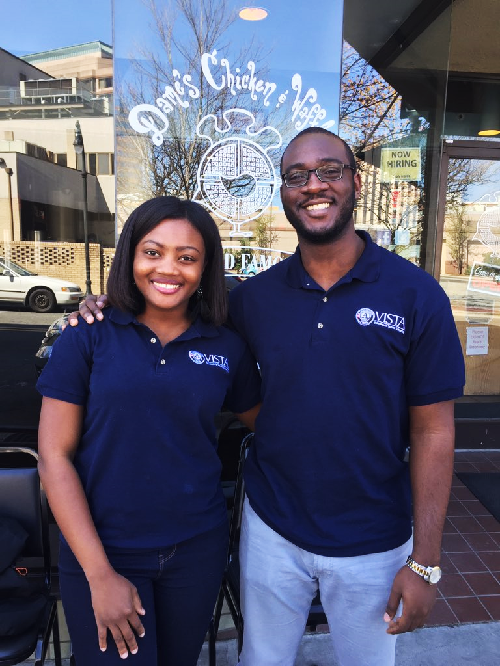
AmeriCorps VISTA
Volunteers in Service to America
Core Principles
Ending poverty
Empowering communities
Building capacity
Creating sustainable solutions
Notes:
Craig
The AmeriCorps VISTA program has been impacting individuals and communities since 1965 and has placed over 220,000 members since that time. VISTA has four core principles that guide our work and the work that sponsors and members accomplish in their communities.
The first principle is ending poverty. A VISTA project's goal is to move individuals and communities out of poverty, rather than making poverty more tolerable through short-term services.
As a way to empower communities, a VISTA project engages residents of low-income communities in planning, development, and implementation of the project.
To build capacity, VISTA members strengthen, expand, and increase the reach of anti-poverty organizations and programs in coordination with staff and volunteers.
Capacity building is a unique feature of the VISTA program – and it is a resource that is much needed in community organizations. VISTA members build capacity for organizations to address poverty long after the VISTAs are gone. They develop systems, relationships, and knowledge which they transfer to the organization and the community to sustain them over the long term.
The annual impact of the work being done in the field is impressive! In FY18 the program engaged over 8,000 members in 4,500 different sites across the United States and territories. The sponsoring organizations and communities received over $195 million in cash and in-kind resources to support the VISTA projects and corresponding events. In addition, over 720,000 volunteers were mobilized to work on programming. VISTA members serve closely with volunteers at some sites and are instrumental in training them and developing processes to build capacity and sustainability.

Slide 12
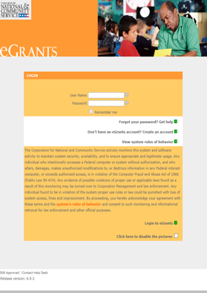
VISTA Sponsor Application Process
Step 1- AmeriCorps VISTA Concept Paper
Organizations submit an AmeriCorps VISTA Concept Paper. The Concept Paper is a preliminary screening tool used to evaluate whether the organization would be an appropriate sponsor.
Step 2- AmeriCorps VISTA Project Application
If CNCS approves the Concept Paper, the
organization submits an AmeriCorps VISTA
Project Application based on the approved
Concept Paper.
Notes:
Melissa
There are two steps to the VISTA program application process. First, the interested organization submits a Concept Paper in the eGrants system. eGrants is a separate system from Grants.gov. Please be sure that you are using eGrants. The organization creates an account and uploads and submits the concept paper in this platform. CNCS reviews the Concept Paper to gain a better understanding of the proposed project and to determine if the activities and the organization are in alignment with VISTA’s programming priorities, which include economic opportunities, education, healthy futures and veterans and military families. The proposed project must be focused on anti-poverty work. The concept paper must clearly demonstrate how the proposed VISTA project breaks the cycle of poverty and helps uplift communities. Concept papers that do not clearly tie to VISTA’s anti-poverty mission will not be approved.
VISTA resources cannot be used to carry out activities for which your organization has already received CNCS/ORE grant dollars to carry out. We’re happy to have VISTA resources support the work, particularly the implementation of the action plans, however, this must be separate from what the Community Conversations grant money is supporting.
The Concept Paper submission deadlines are on a quarterly basis and the next deadline is July 1.
If CNCS approves the Concept Paper, the organization is invited to submit a full application (much of which has already been exported from the responses that the applicant has provided in the Concept Paper). CNCS field staff are available to provide technical assistance and guidance during the writing of both the Concept Paper and the full Application.

Slide 13
Member Recruitment
Service Opportunity Listings and VISTA Assignment Descriptions
VISTA marketing materials
Promote the benefits of service
Professional development
Post opportunities on:
job sites and local job boards (Idealist, LinkedIn, Indeed, SimplyHired, etc.)
social media (Facebook Groups, Twitter, etc.)
community or organization’s bulletin boards and newsletters
Reach out to partners and develop recruitment contacts
Notes:
Melissa
After your application has been approved, CNCS Field Staff can help your organization develop a service opportunity listing to begin the VISTA recruitment efforts. All listings are posted on our AmeriCorps application portal.
At that time the organization will also develop a VISTA Assignment Description. The VAD is the required member position description for each VISTA member. It serves as a powerful guide for recruitment, planning and implementing activities. It can be used to assist with selecting a VISTA candidate, guiding and supporting members during their year of service, and assessing performance by measuring their work against the stated goals and objectives.
VISTA has marketing materials available for sponsors to use during recruitment efforts (brochures, flyers, posters, postcards, email templates, and an online photo library, to name a few).
You should promote benefits of service, such as the – Education Award, Non-competitive eligibility (NCE), and Relocation Assistance.
Be sure to emphasize how your organization and VISTA will provide professional development to members.
Post on job sites like Idealist, Indeed, LinkedIn and local job boards. Also use social media and bulletin boards to get the word out.
Lastly, develop recruitment contacts with local colleges/universities, career centers, and community organizations. Forge connections with the Rotary Club, Lions Club, Links, Top Teens of America or other social organizations in your area. You should ask to give a presentation about your program and any VISTA openings during one of their meetings.

Slide 14
Benefits
Members:
Living Allowance
Receive a modest bi-weekly living allowance to cover basic expenses.
End of Service Award
Choose between a Segal Education Award ($6,095, as of October 2018) to pay for a range of education expenses or a cash stipend ($1,800).
Non-Competitive Eligibility (NCE)
NCE is a unique hiring path which makes it easier for federal agencies to hire you.
Healthcare Benefit
Choose between reimbursement for healthcare or a healthcare plan. Dental and vision are also included.
Sponsoring Organizations:
Capacity
VISTA Members will build and increase the capacity of anti-poverty programs and organizations.
Volunteers Leveraged
VISTA members will assist with recruiting, training and developing volunteer management systems.
Potential Increased Funding
VISTA members may assist with grant-writing and fundraising for your project.
Partnership Development
VISTA members will identify potential partners and maintain existing relationships with organizations and community members.
Program Expansion
VISTA members may conduct outreach to new clients.
Notes:
Craig
The last thing we’d like to touch upon are benefits for both the members and sponsors.
If you become a VISTA sponsor, you will want to know all of the benefits available to VISTA members so that you can support them and inform candidates during the recruitment process. In addition to benefits which range from a living allowance, non-competitive hiring eligibility for federal jobs and an End of Service award, we have many others that aren’t listed, such as student loan forbearance and relocation assistance. Not to mention the fact that AmeriCorps VISTA service time counts towards federal retirement!
To learn more about VISTA member benefits, go to the VISTA webpage or the VISTA Campus.
Sponsoring agencies also receive numerous benefits from hosting a VISTA member, such as strengthening their capacity, recruiting and managing additional volunteers and expanding partnership opportunities in their community. The impact that VISTA members make in their communities is invaluable! Please reach out to your local CNCS field staff if you have any questions and thank you for considering VISTA.

Slide 15
Making the Invisible Visible: A CBPR Study with High School Youth Scientists
Jennifer Willett, PhD
Jenniferwillett@unr.edu
Assistant Professor, University of Nevada, Reno
School of Social Work
With Introduction by Melissa Gouge, PhD, Office of Research and Evaluation, CNCS

Slide 16
Research Team
Notes:
Documenting slow violence (hidden environmental injustices) in Nevada through Photo Voice
Academic partner: 2 UNR Social Work faculty
Community partner: Communities in Schools
Co-Researchers: Youth scientists:15 high school students from Title I high schools
Funder: ORE CNCS

Slide 17
Area of Work: Slow Violence
Hidden environmental problems that occur in historically marginalized or vulnerable communities
The youth scientists lives in these communities
Areas of focus, as determined by the youth:
Winter flooding on homeless populations
Lake flooding an elementary school
Inadequate garbage collections
Comparisons with wealthy neighborhoods
Wildfires
Historic mining pollution
Ditches, flooding, and no sidewalks

Slide 18
Sun Valley
An unincorporated (no local government) area 3 miles north of Reno
Working class
High Latino population
Mobile homes are common
Lack of “normal” infrastructure
Weak non-profit community

Slide 19
Ditches and No Sidewalks
Ditches replace “typical” drainage systems that are underground
No sidewalks
Residents must walk or bike in the street
Residents fall in ditches, especially when full of water during floods
Car/pedestrian accidents are common
Photo by Adan Albarran Ayala

Slide 20
Ditches and No Sidewalks
Photo by Najeh Abduljalil

Slide 21
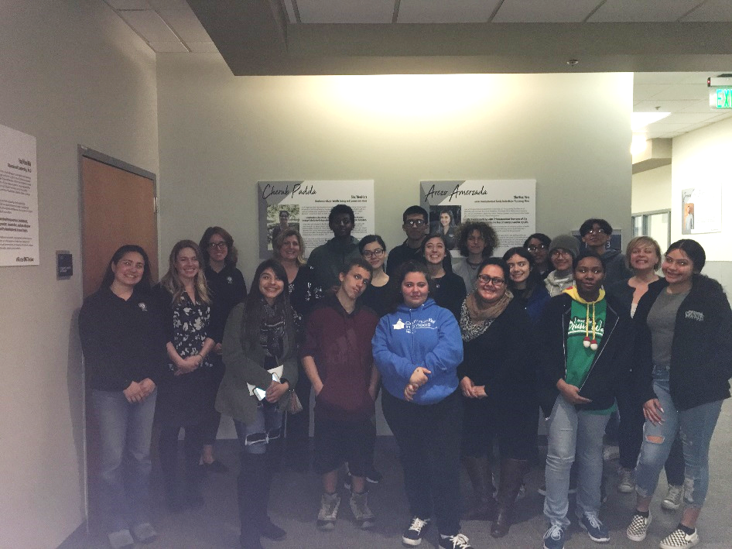
Developing a Partnership
Site visit with ORE, NCCC, and Nevada Volunteers
Amanda, NCCC,
came back a few
weeks later to figure
out how to work
together to find
solutions

Slide 22
Advancing Solutions
AmeriCorps NCCC built sidewalks in another Nevadan community
AmeriCorps NCCC and the Nevada team met with a County Commissioner who was supportive
We presented to the Sun Valley General Improvement District, who were supportive
We met with resources who may be able to provide housing for an AmeriCorps team

Slide 23
Benefits for Research Team
Easier to get in skeptical communities with the AmeriCorps resource
Helpful for youth scientists to work on tangible solutions when environmental problems can be difficult to see on a daily basis
Communities want to do more research with us to find solutions
It’s fun!

