Slide 1
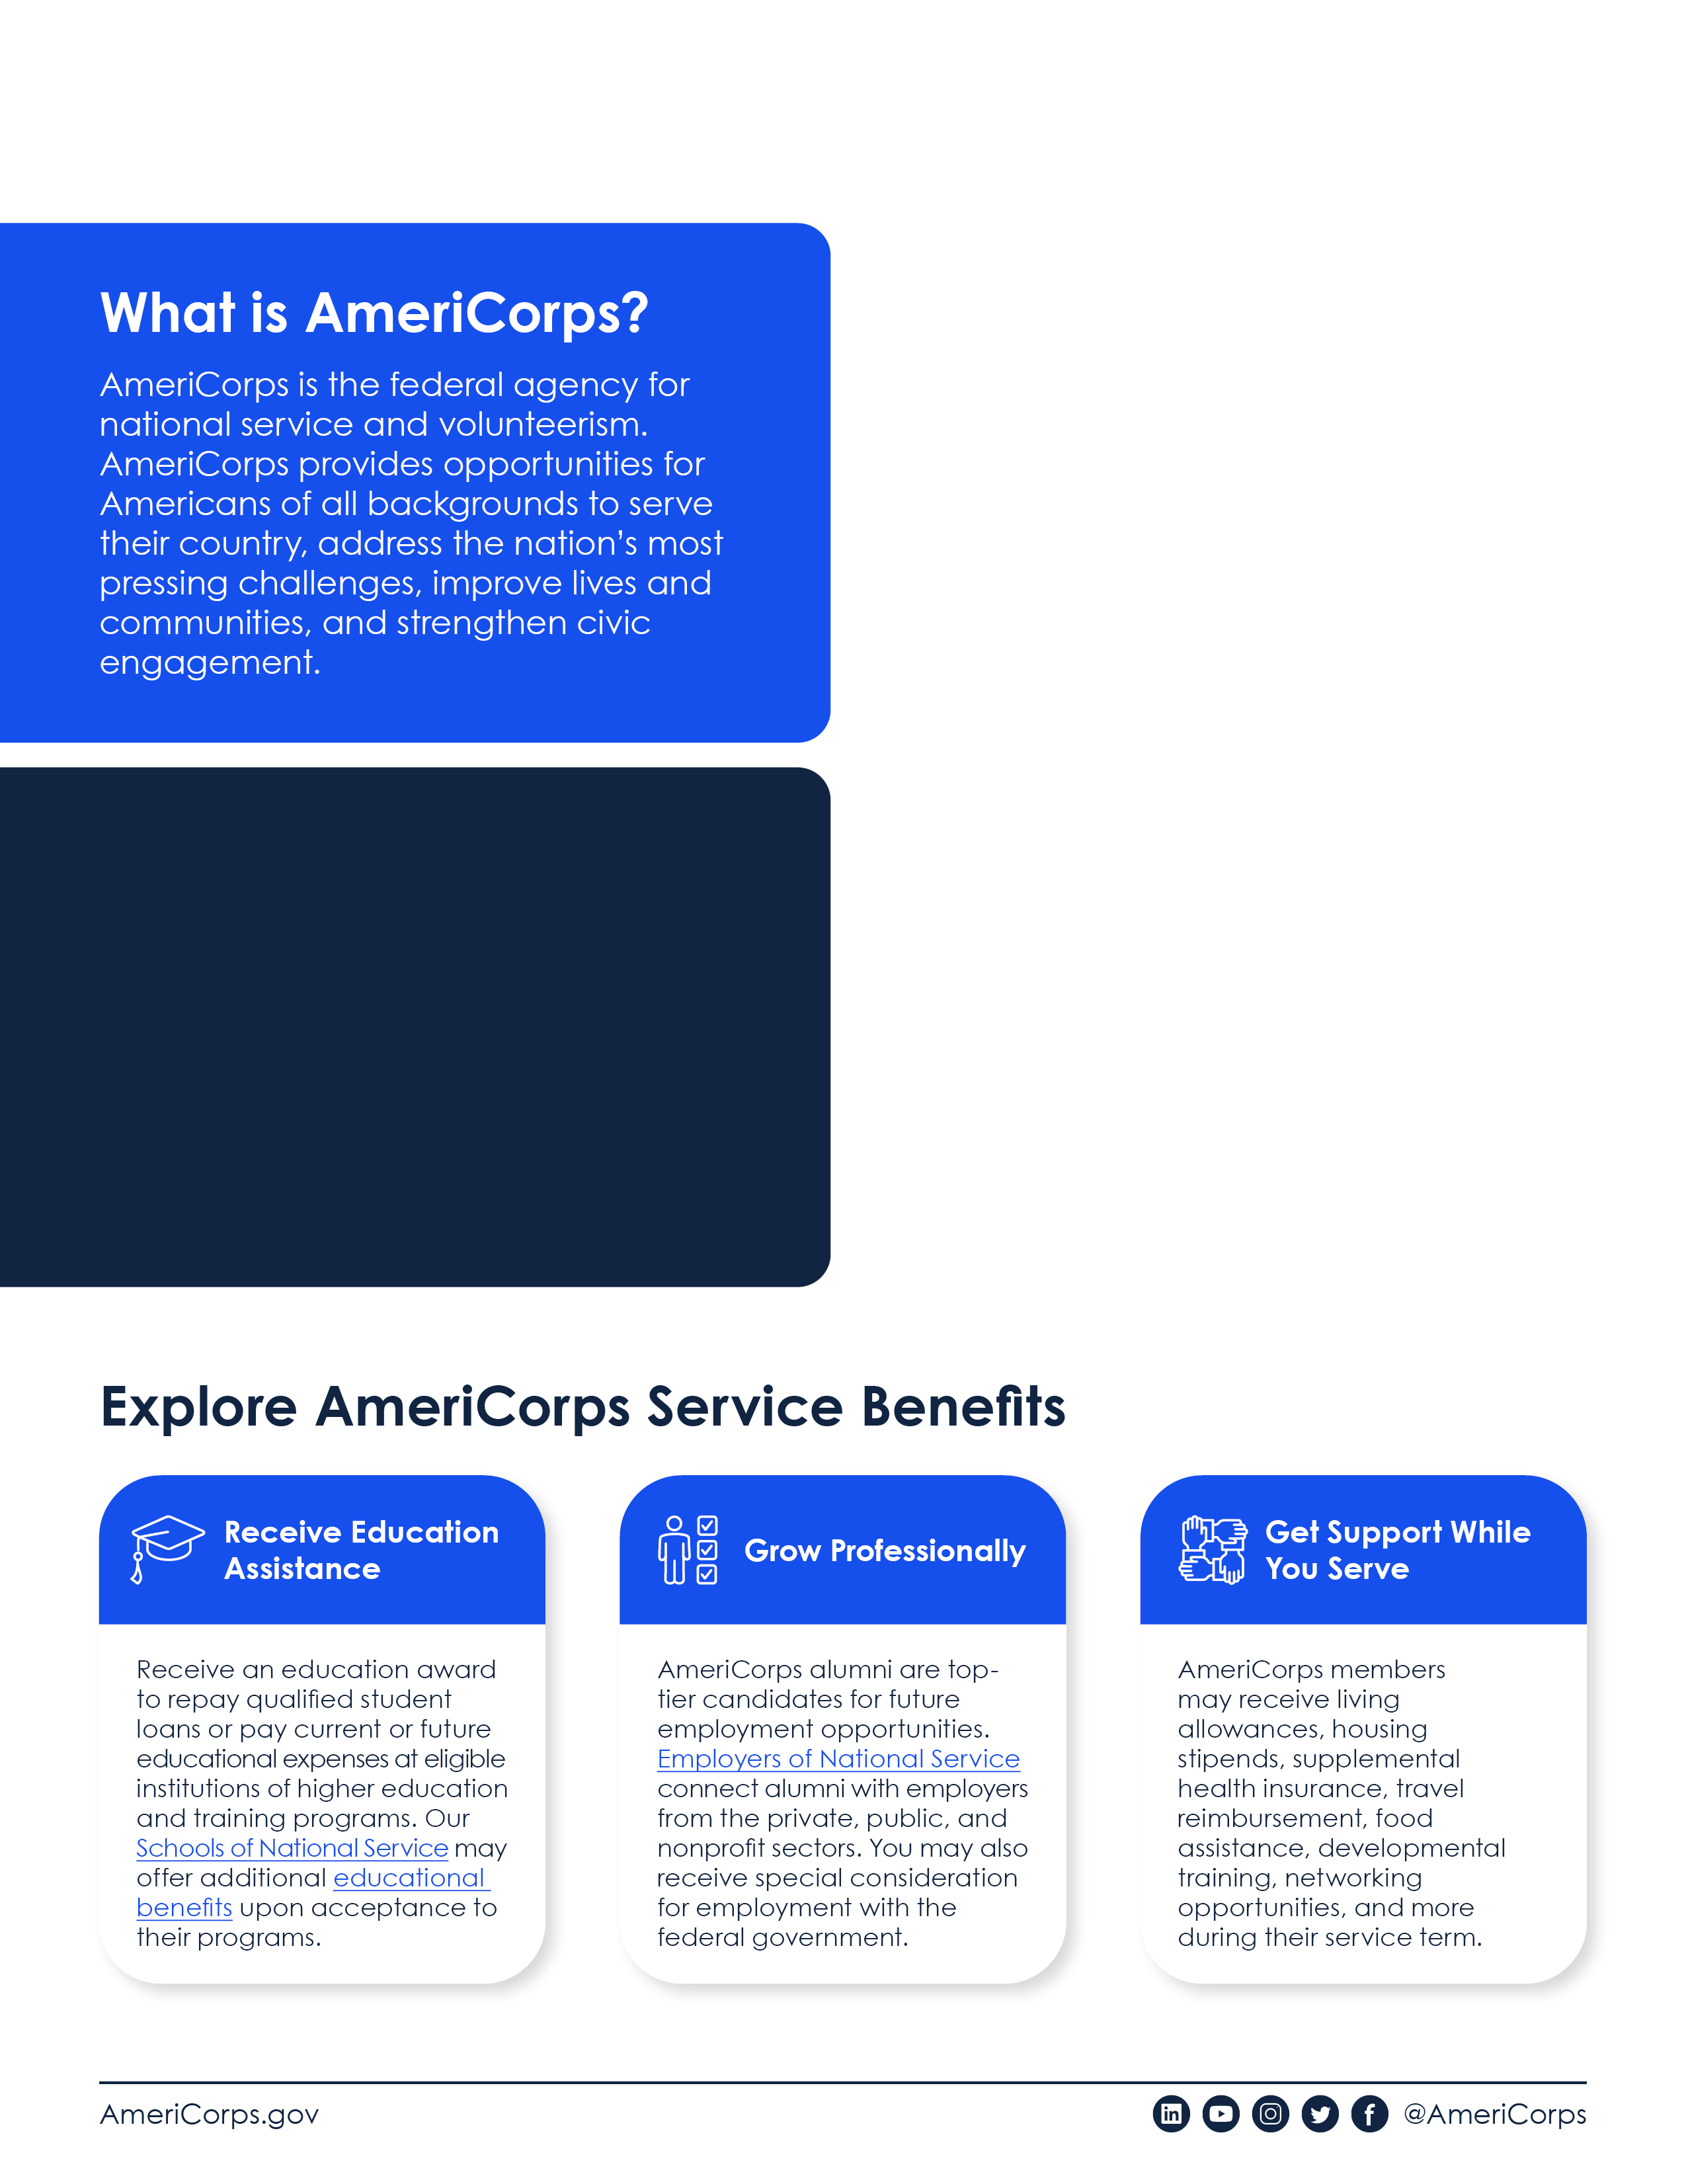
What is [INSERT COMMISION NAME]?
[Insert State Service Commission Details]

Slide 2
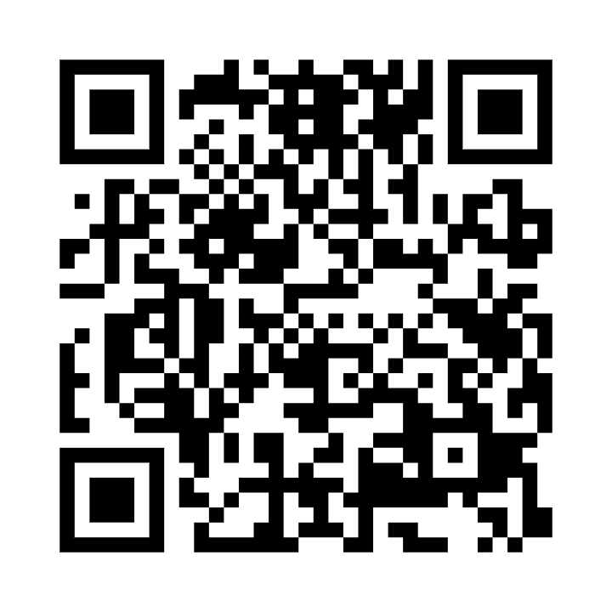
[Grantee/sponsor selects the standard language for the program(s) in their geographic area and supplements with information about their own projects.]
Learn more and get started:
[Grantee website and/or contact information]

