Slide 1
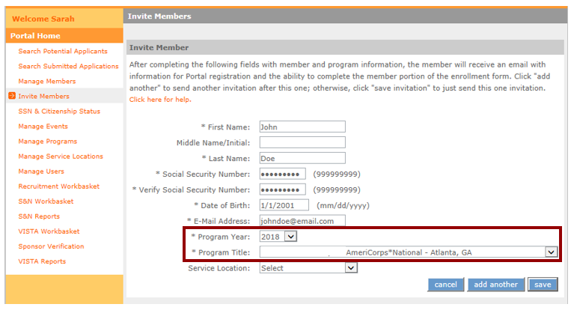
Group Enrollment
Group Enrollment is an option during the final phase of enrollment in eGrants.
Extra step for group enrollment during the invitation process:
Applicants must be associated with the correct Program Year and Program Title
Notes:
Programs wishing to enroll a large number of applicants at one time can use the Group Enrollment option in eGrants. For a program to use the Group Enrollment feature, there are a couple of extra requirements that need to be fulfilled. Specifically, AmeriCorps applicants need to be associated with the correct Program Year and Program Title during the invitation process. (Program Title is another term for the operating site name or subgrantee program name.) This slide shows where these two key fields are located on the applicant invitation screen in the My AmeriCorps Portal.

Slide 2
Special Requirement for Group Enrollment
Continued…
  Program Year must be selected correctly by the program on the applicant invitation
  Applicants who applied via My AmeriCorps will need have the program year entered manually on their individual Enrollment Form, and so cannot participate in group enrollment (i.e., they will not appear on the Group Enrollment tab)
  Program Title (operating site/subgrantee program name) must be selected correctly by the program
  Applicants who applied to/were invited under a different operating site must have the Program Title changed manually on their individual Enrollment Form, and so cannot participate in group enrollment (i.e., they will not appear on the Group Enrollment tab)
Notes:
For individuals to be associated with the correct program year, the program staff responsible for sending applicant invitations in the Portal need to select the program year correctly on the invitation. If an applicant applied and are accepted directly in the My AmeriCorps Portal, their applications will not be associated with a program year; instead, the program year will need to be entered manually on the individual enrollment form later in the enrollment process. As a result, these applicants will not be able to participate in Group Enrollment (in other words, they won’t show up on the Group Enrollment tab in the Portal) and they will need to be enrolled individually instead.
For applicants to be associated with the correct Program Title (i.e., operating site or subgrantee), program staff need to select the correct Program Title during the invitation process. If the wrong Program Title is selected on the applicant invitation, it will need to be changed manually on the individual’s enrollment form later in the process. In this case, again, the affected applicant will not be able to participate in Group Enrollment and will need to be enrolled individually.

Slide 3
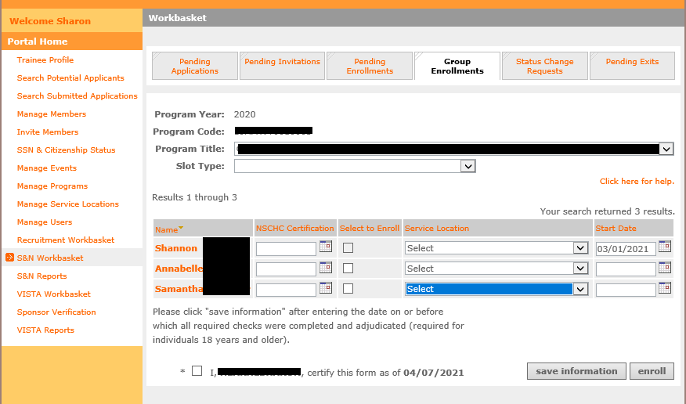
Group Enrollment Screen
Same information needed as in the individual enrollment form with one key difference:
  - On the group enrollment form, you may enter information for up to 20 individuals at a time and enroll them simultaneously.
Notes:
Here is what the group enrollment screen looks like. The placement of the fields on the screen is different, but program staff will still enter the same types of information, make the same certifications, and take the same actions. The key difference: while on the individual enrollment form you are entering information for only one applicant at a time, on the Group Enrollment screen you can enter information for up to 20 applicants at a time and enroll those individuals simultaneously.

Slide 4
Group vs. Individual Enrollment
 | Group Enrollment | Individual Enrollment
Number of applicants enrolled at a time | Up to 20 | Only 1
Program Year and Program Title | Pre-populated from member invitation | Selected manually on enrollment screen
Individuals who applied through My AmeriCorps | Cannot be used | Must be used
Individuals invited under different program year/ program title | Cannot be used | Must be used
SSN/Citizenship | Applicants will not appear on Group Enrollment tab until they have been verified | Verification status and dates visible on individual enrollment screen
NSCHC certification | Certified by entering date on or before which all required NSCHCs were completed and adjudicated (ages 18+) | Certified by entering date on or before which all required NSCHCs were completed and adjudicated (ages 18+)
Notes:
This table shows a summary of the differences between the group enrollment and individual enrollment processes. As I said on the previous slide, group enrollment allows programs to enroll up to 20 individuals at a time, while individual enrollment is limited to one applicant at a time. Also, as I mentioned earlier, in group enrollment the applicant’s program year and program title are set during the invitation process. As a result, individuals who applied and were accepted via My AmeriCorps cannot be enrolled via the group enrollment feature, because the My AmeriCorps application process does not link individuals to this specific information. Similarly, individuals that were invited under a different program year or different program title cannot be enrolled via group enrollment. Instead, the program year and program title for these applicants will need to be selected or changed manually using the individual enrollment form.
In both group enrollment and individual enrollment, the applicant’s SSN and citizenship status needs to be verified on or before the applicant’s start date. Applicants will not show up on the group enrollment screen until this verification is complete. For individual enrollment, the verification status and dates are shown directly on the enrollment form. If you are using group enrollment and need to find out the date of SSN or citizenship verification for a particular individual, you can view it on the individual’s enrollment form.
The rules for National Service Criminal History Checks are the same for both group enrollment and individual enrollment. For applicants ages 18 years or older, program staff must enter the date on or before which the three-part NSCHC was completed and adjudicated. Entering this date and is a legal certification that these actions have been completed and this certification is recorded in the My AmeriCorps Portal. The date of certification is not visible on the group enrollment screen but can be viewed on the applicant’s individual enrollment form.

Slide 5
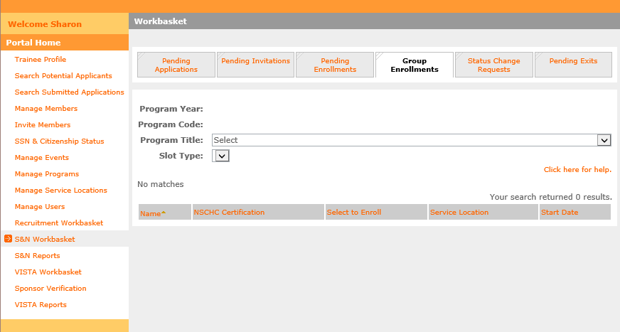
Group Enrollment: Step 1
Step 1:
In the S&N Workbasket in the My AmeriCorps Portal, click on the Group Enrollments tab
Notes:
The next set of slides will walk you step by step through the group enrollment process. First, you need to locate the Group Enrollments tab in the S&N Workbasket of the My AmeriCorps Portal. It is located to the right of the Pending Enrollments tab. When you first click on the tab there will be no applicants listed; the applicants will appear in the next step.

Slide 6
Group Enrollment: Step 2
Step 2: Select the correct Program Title (operating site name or subgrantee program name)
The Program Year whose enrollment period is currently open will populate automatically
Applicants who are associated with this Program Year and Program Title, have completed their portion of the Enrollment Form, and whose SSN/citizenship has been verified will appear on the tab. (These individuals are also visible on the Pending Enrollments tab)
Notes:
The next step is to select the Program Title - meaning the operating site name or subgrantee program name - for the individuals you wish to enroll. There will be a brief pause after the Program Title is selected, then the Program Year will automatically populate on the tab. The Program Year that will appear is the one whose enrollment period is currently open for that particular subgrantee or site.
The applicants associated with that particular Program Title and Program Year will automatically appear in the list at the bottom of the tab. The list displays up to 20 individuals at a time. If there are more than 20 individuals associated with this Program Year and Program Title, you will be able to use the navigation tools on the right side of the screen to move to subsequent pages.
Remember that applicants will only appear on the Group Enrollment tab if (1) they have the correct Program Year and Program Title pre-populated from the invitation form; (2) they have completed their portion of the Enrollment Form; and (3) their SSN and citizenship are already verified. If there are individuals you wish to enroll who do not appear on this tab, you can find them on the Pending Enrollments tab and use the individual enrollment process instead. Applicants who appear on the Group Enrollment tab also appear on the Pending Enrollments tab.

Slide 7
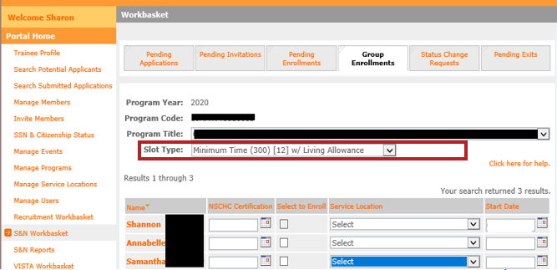
Group Enrollment: Step 3
Step 3: Select the Slot Type for the applicants you wish to enroll
In subsequent steps, you will only enter information for applicants who will be enrolled in this type of slot
If you have applicants that will need to be enrolled in other slot types, leave those blank for now. (You will repeat these steps to enroll those applicants.)
Notes:
Next, you need to select a slot type. In the group enrollment process, all individuals enrolled in a single action must have the same slot type. If you need to enroll other applicants with a different slot type, you will need to repeat the group enrollment steps with the second set of applicants.
In the example on this slide, I intend to Shannon, Annabelle and Samantha as Minimum Time members.

Slide 8
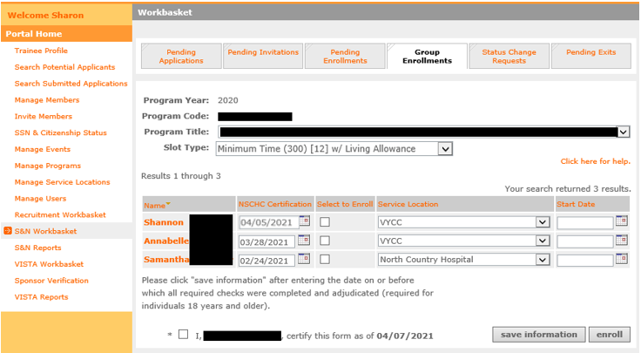
Group Enrollment: Step 4
Step 4: For the applicants you wish to enroll, enter the date when all required National Service Criminal History Checks were completed and adjudicated for each applicant. For applicants under age 18 as of the entered start date, leave the NSCHC Certification field blank.
IMPORTANT:
All required criminal history checks must be completed and adjudicated prior to inputting a certification date
The applicant start date must be after the date entered in the NSCHC Certification field
Notes:
The next step is to enter the date by which the criminal history checks were completed for Shannon, Annabelle and Samantha. Remember that by entering a date, you are providing a legal certification that you have completed and adjudicated the required NSOPW, State, and FBI checks on or before that date. Also remember that, just like on the individual enrollment form, you must enter a start date for the applicant that is AFTER the date in the NSCHC Certification section.
In the example on this slide, I am entering dates in the NSCHC Certification section for Shannon, Annabelle, and Samantha. The NSCHC certifications were completed on different dates for each applicant, so I will need to ensure I have proper documentation to reference when entering this date.

Slide 9
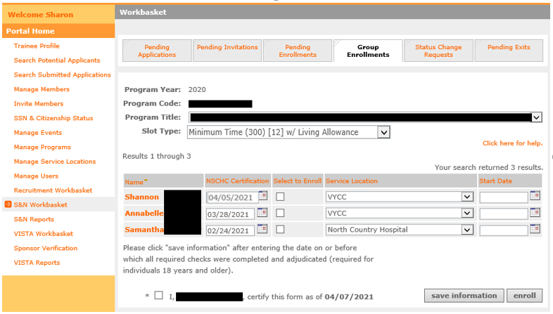
Group Enrollment: Step 5
Step 5: For the applicants you wish to enroll, select the appropriate Service Location(s)
Service Locations must be set up in the My AmeriCorps Portal prior to taking this step
Notes:
Next, I need to select service locations. For the correct service locations to show up in the drop-down list for these applicants, the service locations need to have been set up previously in the My AmeriCorps Portal. Please see the complete Member Enrollment training for more information about this prior step.​
​
Note that the service locations can be different for each individual in the group enrollment process. In this example, Shannon is being assigned to VYCC while Samantha is being assigned to North Country Hospital.

Slide 10
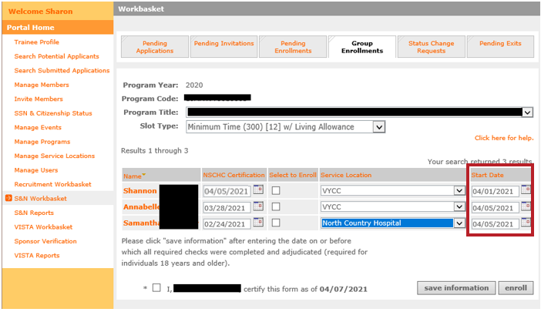
Group Enrollment: Step 6
Step 6: For the individuals you wish to enroll, enter the correct Start Date
Must be within member enrollment period
Must be on or after the SSN/citizenship verification dates
Must be after the date entered in the NSCHC Certification field
Per AmeriCorps policy, enrollment should be certified within 8 days of the member’s start date
Notes:
Now it’s time to enter start dates.
Remember, in order to enroll an applicant, the correct start date must:
Must be within member enrollment period
Must be on or after the SSN/citizenship verification dates
Must be after the date entered in the NSCHC Certification field
Annabelle and Samantha will start on 4/5/21. For Shannon I have selected 4/1/21 as a start date. However, I just completed the criminal history check certifications on 4/5/21 which is after the selected start date, so I will violate the third bullet. In other words, a 4/1 start date is not actually going to be possible for Shannon. But let’s leave it there for now and see what happens.
Per AmeriCorps policy, member enrollments should be certified within 8 days of the member start date.

Slide 11
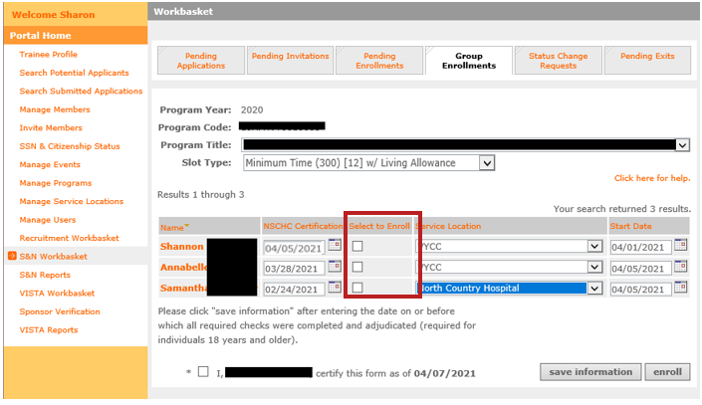
Group Enrollment: Step 7
Step 7: For the individuals you wish to enroll, click the “Select to Enroll” box
Only the individuals with this box checked will be enrolled when you click the “enroll” button at the bottom of the tab
Notes:
The next step will be to check the “Select to Enroll” boxes since these are the applicants I want to enroll in minimum slots under this Program Title and Program Year. Only the applicants whose “Select to Enroll” boxes are checked will be affected when the “Enroll” button is clicked at the bottom of the tab.

Slide 12
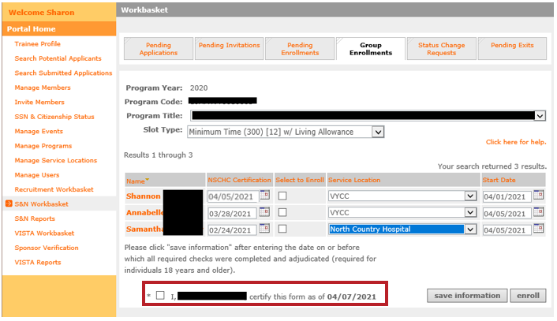
Group Enrollment: Step 8
Step 8: At the bottom of the tab, certify the form
Notes:
The form needs to be certified at the bottom of the tab. This legal certification confirms that all the information provided on the form is correct and complete, including the criminal history check certification dates.

Slide 13
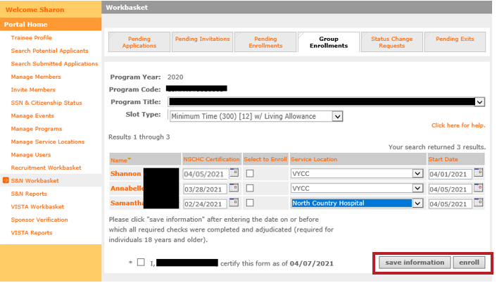
Group Enrollment: Step 9
Step 9: At the bottom of the tab, take the “enroll” action. (If you are not ready to enroll the individuals yet, click the “save information” button instead)
Up to 20 individuals can be enrolled at a time
Notes:
The next step is click the “enroll” button at the bottom of the tab to attempt to enroll the applicants. The key word here is attempt – clicking this button is not a guarantee that all the enrollments will be successful. The next tab will show you what happens if one or more of the enrollments does not go through.
As a reminder: up to 20 individuals can be enrolled at one time using the group enrollment process. If you have filled out information on this tab for one or more applicant but aren’t yet ready to take the “Enroll” action, click “Save information” instead.

Slide 14
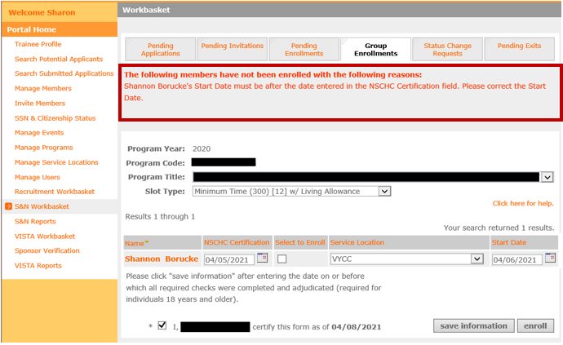
Group Enrollment: Step 10
Step 10: Check for error messages at the top of the tab. These messages will indicate if one or more of the individuals' enrollments was not successful.
In this example, the start date entered for Shannon was prior to the date of the NSCHC Certification, so they could not be enrolled. Program staff will need to correct Shannon’s start date and try again.
Notes:
If one or more of your enrollment attempts was not successful, you will see a red error message at the top of the tab. The message will tell you which applicants were not enrolled, and why. Applicants that were successfully enrolled will disappear from the Group Enrollment tab, while applicants who were not successfully enrolled will continue to be visible.
In this example Annabelle and Samantha’s enrollment was successful, so they are no longer displayed on this tab. However, as predicted, Shannon’s enrollment was not successful because the start date entered for them was before the NSCHC certification. So, Shannon still appears on the Group Enrollment tab. Program staff will need to correct Shannon’s start date, check the “Select to Enroll” box again, and try again to enroll them.

Slide 15
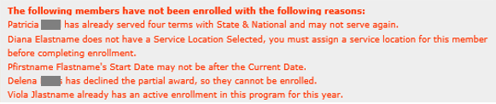
Troubleshooting Enrollment Error Messages
Sufficient slots available
SSN and citizenship verified on or before member start date
NSCHC Certification date before member start date
Service Location selected
Member start date no later than today’s date
Applicant is eligible to serve
  Has not previously served more than 4 terms
  Has not declined a partial education award
  Has not received an unsatisfactory performance rating from a previous term of service
  Is not currently actively enrolled in the same program or in another term that when combined exceeds full-time service
The details of the error message will provide specific guidance
Notes:
There are several reasons why member enrollments might not be successful; some of the possibilities are listed on this tab. ​
It could be that the program doesn’t have enough slots available to enroll all the selected applicants in that particular slot type. ​
It could be that the start date was entered wrong, or that the program staff forgot to select the applicant’s service location. ​
It could be that the applicant has not yet been exited from a current full-time service term.​
Or it could be that the applicant themself was not eligible to serve: they may have previously served four terms with AmeriCorps State and National or received an unsatisfactory performance rating from a prior service term.​
Whatever the reason, the error message will provide you with details about what went wrong and, if possible, what you can do to correct it. The member enrollment WILL NOT be complete until the error is corrected, and program staff successfully take the Enroll action again.

