Slide 1
New Commissioner Orientation
Notes:
New Commissioner Orientation
This presentation was designed for newly appointed members of State Service Commissions. Commission staff may use this presentation in its entirety to orient new commissioners or excerpt relevant parts to use as part of the commission’s training plan. This presentation was updated and published on the National Service Knowledge network in January 2016.

Slide 2
Welcome!
“You can do what I cannot do.
I can do what you cannot do.
Together we can do great things.”
--Mother Teresa
Notes:
Welcome!
Welcome to the national service commission network. Your service as a commissioner supports a vibrant field of service programs, professional staff, and AmeriCorps members. Each of us plays a role in the national service field, and our strengths complement each other and allow us to accomplish great tasks together. This idea is reflected in the following quote:
“You can do what I cannot do.
I can do what you cannot do.
Together we can do great things.”
--Mother Teresa

Slide 3
Orientation Contents
National service legislation
CNCS structure and funding
National service programs
State Service Commission structure
and activities
Key events in national service history
Commissioner resources
Notes:
Orientation Contents
To help you become familiar with your new role as a State Service Commissioner, this orientation will cover these topics:
--National service legislation
--CNCS structure and funding
--National service programs
--State Service Commission structure and activities
--Key events in national service history
--Commissioner resources
This presentation was developed over several years by staff of the Corporation for National and Community Service, staff of a variety of State Service Commissions, and other colleagues in the national service field.

Slide 4
National Service Legislation
The National and Community Service Act of 1990
Amended by the National and Community Service Trust Act of 1993
Amended by the Edward M. Kennedy Serve America Act of 2009
Notes:
National Service Legislation
The following federal laws define the purpose and structure of national service:
--The National and Community Service Act of 1990
--Amended by the National and Community Service Trust Act of 1993
--Amended by the Edward M. Kennedy Serve America Act of 2009

Slide 5
National and Community Service
Trust Act of 1993
Established State Service Commission composition requirements, created the Corporation for National and Community Service, and more
Details may be found on the CNCS website:
www.nationalservice.gov/about/legislation
Notes:
National and Community Service Trust Act of 1993
The National and Community Service Trust Act of 1993 (known as the national service public law) established state commissions and defined their appointment and size, composition and membership, and commissioner duties.
Details about the public law and other national service legislation can be found on the CNCS website at www.nationalservice.gov/about/legislation.

Slide 6

What is CNCS?
Notes:
What is CNCS?
Established in 1993, the Corporation for National and Community Service (CNCS) is a federal agency that engages more than 5 million Americans in service through its core programs -- Senior Corps, AmeriCorps, and the Social Innovation Fund -- and leads President Obama’s national call to service initiative, United We Serve.
As the nation’s largest grantmaker for service and volunteering, CNCS plays a critical role in strengthening America’s nonprofit sector and addressing our nation’s challenges through service.

Slide 7
Why a Corporation?
Part of an effort to streamline the federal government in the Clinton administration
Features include:
    Board of Directors
    Performance-based workplans and assessments
    “Flatter” organizational structure
    Corporate donations
    Reduce red tape
Allows CNCS to be more accountable to Congress and the public
Notes:
Why a Corporation?
CNCS was established in 1993, in the midst of efforts across the federal government to reinvent the structure and flexibility of government entities. The agency was named a corporation in an effort to allow it to operate in a manner similar to large businesses in the private sector. The structure was intended to allow a more streamlined, accountable, and customer service-based organization.
Features of this organizational structure include:
--Board of Directors
--Performance-based workplans and assessments
--“Flatter” organizational structure
--Corporate donations
--Reduce red tape
This structure allows CNCS to be more accountable to Congress and to the general public.

Slide 8
CNCS Mission
To improve lives, strengthen communities, and foster civic engagement through service and volunteering.
www.nationalservice.gov
Notes:
CNCS Mission
The mission of CNCS is: To improve lives, strengthen communities, and foster civic engagement through service and volunteering.
Additional information on the agency’s history and structure may be found on the CNCS website at www.nationalservice.gov.

Slide 9
Guiding Principles of CNCS
Put the needs of local communities first.
Strengthen the public-private partnerships that underpin all of our programs.
Use our programs to build stronger, more efficient, and more sustainable community networks capable of mobilizing volunteers to address local needs, including disaster preparedness and response.
Measure and continually improve our programs' benefits to service beneficiaries, participants, community organizations, and our national culture of service.
Build collaborations wherever possible across our programs and with other federal programs.
Notes:
Guiding Principles of CNCS
These are the guiding principles of CNCS:
--Put the needs of local communities first.
--Strengthen the public-private partnerships that underpin all of our programs.
--Use our programs to build stronger, more efficient, and more sustainable community networks capable of mobilizing volunteers to address local needs, including disaster preparedness and response.
--Measure and continually improve our programs' benefits to service beneficiaries, participants, community organizations, and our national culture of service.
--Build collaborations wherever possible across our programs and with other federal programs.

Slide 10
Guiding Principles of CNCS
Help rural and economically distressed communities obtain access to public and private resources.
Support diverse organizations, including faith-based and other community organizations, minority colleges, and disability organizations.
Use service-learning principles to put volunteer and service activities into an appropriate context that stimulates life-long civic engagement.
Support continued civic engagement, leadership, and public service careers for our programs' participants and community volunteers.
Exhibit excellence in management and customer service.
Notes:
CNCS Guiding Principles – continued from previous slide
--Help rural and economically distressed communities obtain access to public and private resources.
--Support diverse organizations, including faith-based and other community organizations, minority colleges, and disability organizations.
--Use service-learning principles to put volunteer and service activities into an appropriate context that stimulates life-long civic engagement.
--Support continued civic engagement, leadership, and public service careers for our programs' participants and community volunteers.
--Exhibit excellence in management and customer service.

Slide 11
CNCS Strategic Plan
The current strategic plan may be found at www.nationalservice.gov/about/strategic-plan.
The plan identifies these agency goals:
    Goal 1: Increase the impact of national service on community needs in communities served by CNCS-supported programs.
    Goal 2: Strengthen national service so that participants engaged in CNCS-supported programs consistently find satisfaction, meaning, and opportunity.
    Goal 3: Maximize the value we add to grantees, partners, and participants.
    Goal 4: Fortify management operations and sustain a capable, responsive, and accountable organization.
Notes:
CNCS Strategic Plan
The current strategic plan for CNCS may be found at www.nationalservice.gov/about/strategic-plan.
The plan identifies these agency goals:
Goal 1: Increase the impact of national service on community needs in communities served by CNCS-supported programs.
Goal 2: Strengthen national service so that participants engaged in CNCS-supported programs consistently find satisfaction, meaning, and opportunity.
Goal 3: Maximize the value we add to grantees, partners, and participants.
Goal 4: Fortify management operations and sustain a capable, responsive, and accountable organization.

Slide 12
CNCS Structure
Chief Executive Officer
Board of Directors
AmeriCorps State and National
Senior Corps
Field Liaison
AmeriCorps VISTA
AmeriCorps NCCC
Social Innovation Fund
Chief of Staff
Chief Strategy Officer
General Counsel
External Affairs
Government Relations
Chief Operating Officer
Research and Evaluation
Accountability and Oversight
Information Technology
Chief Financial Officer
Human Capital
Inspector General
Notes:
CNCS Structure
CNCS is managed by a Chief Executive Officer, who is appointed by the President, and a management team of federal employees. CNCS programming and grantmaking fall into several categories: AmeriCorps State and National, AmeriCorps VISTA, AmeriCorps NCCC, and the Social Innovation Fund. There are also senior staff positions and support staff in the Office of Field Liaison, the Office of the General Counsel, and more.
CNCS is governed by the Board of Directors, which sets policies and direction for the agency. The Board is responsible for all actions taken by the CEO regarding standards, policies, procedures, programs, and initiatives as are necessary to carry out the mission of the agency.
Board members serve three year terms and are appointed by the President. The Board meets quarterly.
The Office of Inspector General is an independent office; the OIG routinely audits and conducts investigations of CNCS operations and grantees.

Slide 13
CNCS Funding
President's Budget Request
Congressional Budget Resolution
Budget Enactment
Notes:
CNCS Funding
CNCS is funded through the federal government budget process.
Step One: The President’s Budget Request
On or before the first Monday in February, the President submits his federal budget request for the upcoming federal fiscal year (October 1 – September 30). The budget request is developed by the Office of Management and Budget (OMB), and the request outlines federal spending priorities and policy changes. The President’s budget outlines specific funding levels for all federal programs.

Slide 14
CNCS Funding
President's Budget Request
Congressional Budget Resolution
Budget Enactment
Notes:
CNCS Funding
Step Two: Congressional Budget Resolution
After the President’s budget is released, the House and Senate Budget Committees develop their budget resolutions. The committees typically hold hearings with department officials to gather information and inform their resolutions. When the House and Senate Budget Committees have completed their budget resolutions, they go to the House and Senate floors for discussion and amendment (by a majority vote). Once passed, the budgets go to a House-Senate conference to resolve any differences, and a conference report is passed by both houses. The budget resolution deadline is April 15; should the process take longer, the budget can go to a continuing resolution to extend the time for deliberation and decision.

Slide 15
CNCS Funding
President's Budget Request
Congressional Budget Resolution
Budget Enactment
Notes:
CNCS Funding
Step Three: Budget Enactment
Once Congress passes the federal budget, federal agencies receive their annual appropriations and conduct their annual program activities as defined by the budget law.

Slide 16
Types of AmeriCorps State and National Prime Grantees
1. Direct Programs
    National or multi-state programs
    Programs managed by Indian Tribes
    Programs managed by US Territories
    Programs funded in states without a commission
2. State Service Commissions
    Professional staff
    Appointed commissioners
Notes:
Types of AmeriCorps State and National Prime Grantees
1, Direct Programs
--National or multi-state programs
--Programs managed by Indian Tribes
--Programs managed by US Territories
--Programs funded in states without a commission
Direct programs receive Competitive AmeriCorps funding from CNCS. CNCS staff members oversee direct program grants.
2. State Service Commissions
--Professional staff
--Appointed commissioners
Note that State Service Commissions receive Competitive and Formula AmeriCorps funding to support state and local AmeriCorps programs. These programs are called subgrantees of the commission, and the grants are managed by the commission staff.

Slide 17
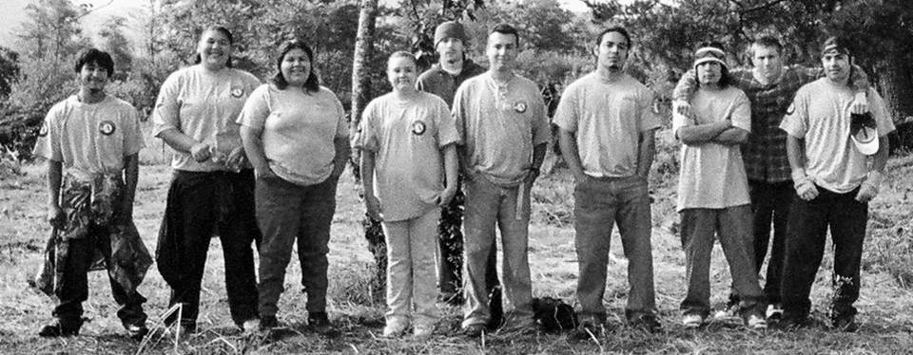
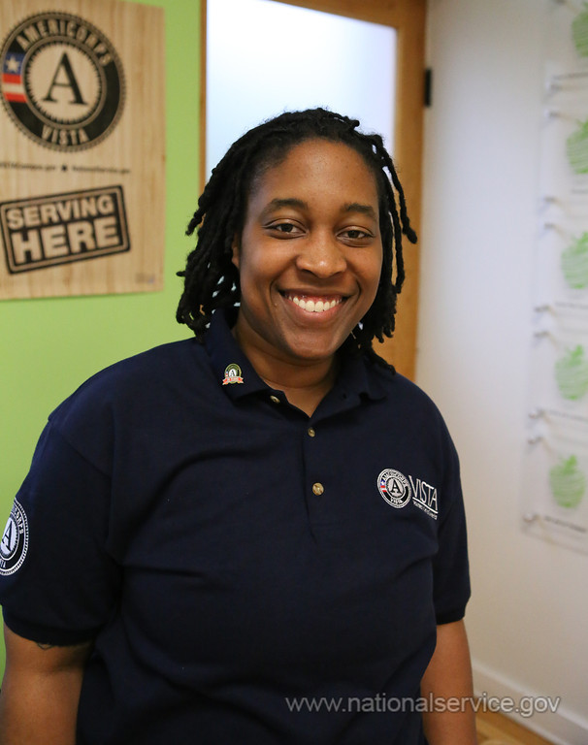

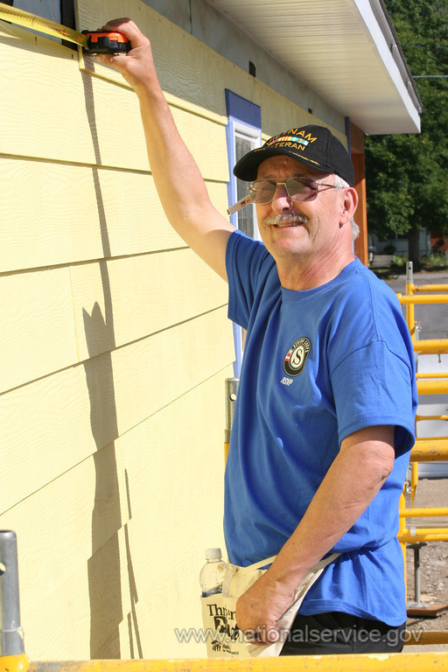
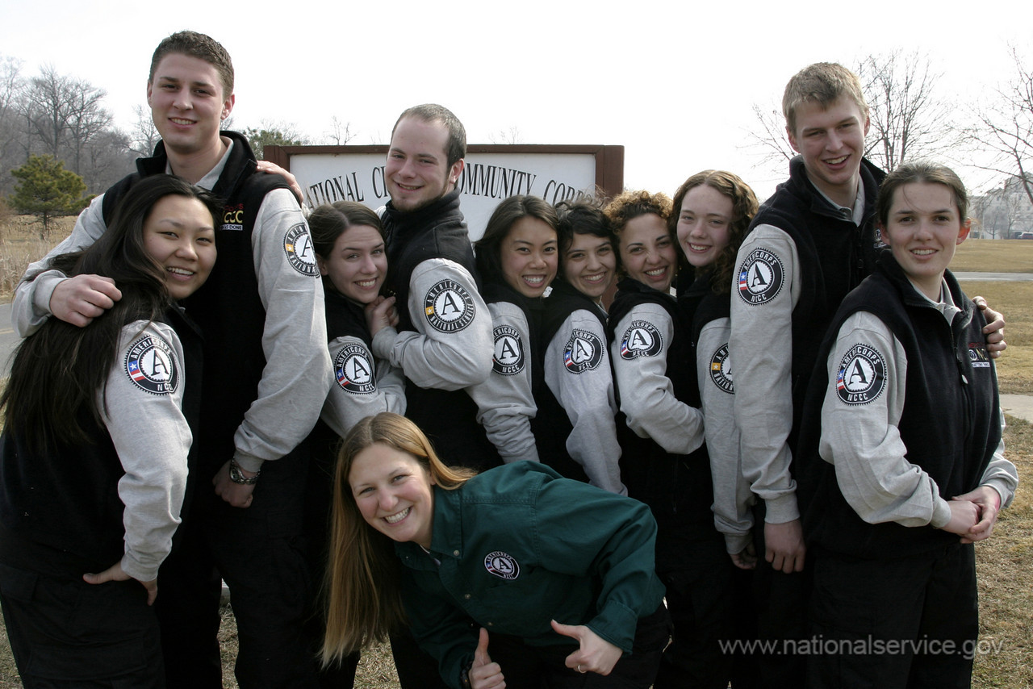

What are National Service Programs?
Notes:
What are National Service Programs?
In 1993, CNCS was established to connect Americans of all ages and backgrounds with opportunities to give back to their communities and their nation. It merged the work and staff of two existing federal agencies: ACTION and the Commission on National and Community Service.
At its inception, CNCS was directed to manage three main programs:
1. The newly created Senior Corps (http://nationalservice.gov/programs/senior-corps), which incorporated Foster Grandparents, RSVP (Retired and Senior Volunteer Program), and Senior Companion programs;
2. The newly created AmeriCorps (http://nationalservice.gov/programs/americorps), which incorporated VISTA, the new National Civilian Community Corps, and the full-time demonstration programs that had been established under the 1990 Act; and
3. Learn and Serve America, formerly known as Serve America.
Today CNCS serves more than 5 million individuals of all ages and backgrounds help meet local needs through a wide array of service programs. These include projects in six priority areas: disaster services, economic opportunity, education, environmental stewardship, healthy futures, and veterans and military families through CNCS core programs: AmeriCorps, Senior Corps, and the Social Innovation Fund.

Slide 18
AmeriCorps Programs
AmeriCorps
NCCC
State and National
VISTA
Notes:
AmeriCorps Programs
AmeriCorps engages more than 80,000 Americans in intensive service each year at nonprofits, schools, public agencies, and community and faith-based groups across the country. Since the program’s founding in 1994, more than 800,000 AmeriCorps members have contributed more than one billion hours in service across America while tackling pressing problems and mobilizing millions of volunteers for the organizations they serve.
There are three AmeriCorps program departments at CNCS: NCCC, State and National, and VISTA.

Slide 19
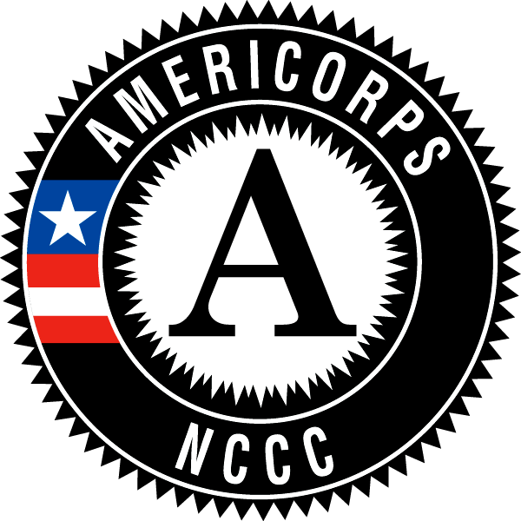
National Civilian Community Corps
Notes:
National Civilian Community Corps
The AmeriCorps National Civilian Community Corps (NCCC, pronounced N triple C) is a full-time, team-based, residential program for men and women, ages 18-24. Its mission is to strengthen communities and develop leaders through direct, team-based national and community service. Working in teams of 10-14, approximately 1,100 AmeriCorps NCCC members, based at regional campuses, take on a series of projects throughout their respective regions. Because members are trained in first aid and can be assigned to new duties on short notice, NCCC members are particularly well-suited to respond in times of disaster.
For example, following the devastation brought by Hurricanes Katrina and Rita in 2005, over 2,200 AmeriCorps NCCC members served at 100 separate disaster service projects on the Gulf Coast. Members served alongside the American Red Cross, the Federal Emergency Management Agency, and State Service Commissions in the region.

Slide 20

AmeriCorps State and National
Notes:
AmeriCorps State and National
This is the broadest network of AmeriCorps programs. These groups recruit, train, and place AmeriCorps members to meet critical community needs in disaster services, education, economic opportunity, healthy futures, veterans and military families, and environmental stewardship.
Approximately two-thirds of all AmeriCorps State and National funding is granted through Governor-appointed State Service Commissions. These commissions award grants to nonprofits and government programs to recruit, train, and manage AmeriCorps members in their communities.
The remaining funds support AmeriCorps members who serve in tribal programs, programs that operate in territories outside the US, and national/multi-state programs.

Slide 21
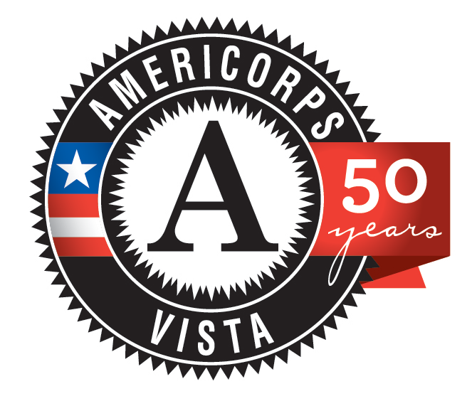
Volunteers in Service to America
Notes:
Volunteers in Service to America
AmeriCorps VISTA helps individuals and communities implement grassroots solutions designed to alleviate poverty. Founded as Volunteers In Service To America in 1965, VISTA places full-time members in nonprofit, faith-based and other community organizations, and public agencies to create and expand programs that bring low-income individuals and communities out of poverty.

Slide 22
Senior Corps Programs
Senior Corps
FGP
RSVP
Senior Companion
Notes:
Senior Corps Programs
Senior Corps connects adults, ages 55+, with the people and organizations that need them most. Senior Corps engages citizens as mentors, coaches, or companions to people in need, or contribute their job skills and expertise to community projects and organizations. Volunteers receive guidance and training so they can make a contribution that suits their talents, interests, and availability.
Senior Corps currently links more than 360,000 Americans to service opportunities. Their contributions of skills, knowledge, and experience make a real difference to individuals, nonprofits, and faith-based and other community organizations throughout the US.

Slide 23

Foster Grandparent Program
Notes:
Foster Grandparent Program
Foster Grandparents serve as role models, mentors, and friends. Serving at one of thousands of local organizations, Foster Grandparents help children learn to read.

Slide 24

Retired Senior Volunteer Program
Notes:
Retired Senior Volunteer Program
RSVP offers a full range of volunteer opportunities with thousands of local and national organizations.

Slide 25

Senior Companion Program
Notes:
Senior Companion Program
Senior Companions perform a variety of services that include giving families or professional care-givers much-needed time off, running errands, or simply being a source of comfort and friendship.

Slide 26
What is a State Service Commission?
A bipartisan or nonpartisan state entity, approved by CNCS, consisting of 15-25 members who are appointed by the Governor or chief executive officer of the state
Commissioners are appointed to voluntary service, and they work with paid, professional staff to fulfill the service goals of the state
Notes:
What is a State Service Commission?
When the Corporation for National and Community Service was created in 1993, Congress charged states with a critical role in managing national service resources. The National and Community Service Trust Act of 1993 gives State Service Commissions a vital role. These 15 to 25 member bodies are appointed by each state’s governor.
State Service Commissions are comprised of volunteer/appointed commissioners and professional staff.

Slide 27
Commission Structure
Appointed commissioners include:
A Chairperson elected by the voting members
A CNCS representative
Membership defined in federal law
Commission professional staff include:
An Executive Director
Program Officer(s)
Fiscal Officer(s)
Outreach Manager
*Note that the commission staff titles will depend on the organizational structure.
Notes:
Commission Structure
Appointed commissioners include:
--A Chairperson elected by the voting members
--A CNCS representative
--Membership defined in federal law
Commission professional staff include:
--An Executive Director
--Program Officer(s)
--Fiscal Officer(s)
--Outreach Manager
*Note that the commission staff titles will depend on the organizational structure.

Slide 28
Commission Responsibilities
Commission
Stewardship of Public Resources
National Service Plan
Notes:
Commission Responsibilities
All commissions, regardless of their organizational type, share the same requirements under the national service law. The law identifies tasks related to two key areas of responsibility: assuring good stewardship of the AmeriCorps State resources in the state and preparing a national service plan for the state.
Stewardship duties of the state commission include:
--Administration of a grant program in support of national service which includes selection, oversight, and evaluation of grant recipients
--Development of projects, training methods, curriculum and training materials, and other activities related to national service programs
--Providing technical assistance to grant applicants
--Developing and communicating a state-wide vision of service
--Fostering an ethic of service and volunteering throughout the state
National service plan duties include:
--Develop the plan through an open and public process
--Ensure outreach to diverse community-based agencies that serve under-represented populations
--Prepare a plan that covers a three-year period and is updated annually

Slide 29
Special Role of Commissions
It is important to note that State Service Commissions may lead other significant functions within their states, including disaster response, state volunteer centers and networks, and more
Commissions are invaluable partners in AmeriCorps grantmaking with CNCS
Notes:
Special Role of Commissions
--It is important to note that State Service Commissions may lead other significant functions within their states, including disaster response, state volunteer centers and networks, and more
--Commissions are invaluable partners in AmeriCorps grantmaking with CNCS and their states and local communities

Slide 30
AmeriCorps Grant Terms and Conditions
General
Issued by CNCS
Guiding Principles
Program and Financial
Grantee and Subgrantee
Notes:
AmeriCorps Grant Terms and Conditions
The oversight and monitoring of subgrantee compliance with national service laws, regulations, and grant terms and conditions are some of the most critical tasks performed by State Service Commissions. Together with CNCS, commissions work to ensure that all AmeriCorps grantees and subgrantees follow federal guidance for program and financial management, adhere to CNCS guiding principles and published rules, and fulfill the goals and objectives outlined in approved funding applications.
These tasks are most often performed by the professional staff of the commissions; however, it is extremely important that all commissioners are aware of the federal guidance that oversees the public funds and AmeriCorps resources.

Slide 31
State Commission Members
§2550.50 (b) Required voting members on a State Service Commission. A member may represent none, one, or more than one category, and each of the following categories must be represented:
A representative of a community-based agency or organization in the state
The head of the state education agency or his or her designee
A representative of local government in the state
A representative of local labor organizations in the state
A representative of business
An individual between the ages of 16 and 25, inclusive, who is a participant or supervisor of a service program for school-age youth, or of a campus-based or national service program
A representative of a national service program
An individual with expertise in the educational, training, and development needs of youth, particularly disadvantaged youth
An individual with experience in promoting the involvement of older adults (age 55 and older) in service and volunteerism
A representative of the volunteer sector
Notes:
State Commission Members
Citation from the Code of Federal Regulations, §2550.50 (b) Required voting members on a State Service Commission. A member may represent none, one, or more than one category, and each of the following categories must be represented:
--A representative of a community-based agency or organization in the state
--The head of the state education agency or his or her designee
--A representative of local government in the state
--A representative of local labor organizations in the state
--A representative of business
--An individual between the ages of 16 and 25, inclusive, who is a participant or supervisor of a service program for school-age youth, or of a campus-based or national service program
--A representative of a national service program
--An individual with expertise in the educational, training, and development needs of youth, particularly disadvantaged youth
--An individual with experience in promoting the involvement of older adults (age 55 and older) in service and volunteerism
--A representative of the volunteer sector

Slide 32
Organizational Structures
Commission Host Agency
Office of the Governor
Other State Government
Nonprofit
Notes:
Organizational Structures
The national service legislation describes the size, composition, and membership requirements for State Service Commissions. Every commission meets these requirements by working with the Governor and the appropriate gubernatorial staff to nominate and select appropriate individuals to serve on the commission.
Structurally, commissions generally fit into one of these categories:
--Housed in the Office of the Governor or Lt Governor
--Housed in another state office or agency
--Incorporated as an independent, 501c3 nonprofit organization

Slide 33

Commission in the Office of the Governor
Operating office within structure of Governor’s Office or housed within a larger agency in the Governor’s Office
Examples include commissions in Maryland, Florida, and Montana
Notes:
Commission in the Office of the Governor
Commissions housed in the office of the Governor or the Lt Governor are often included in the Governor’s budget and are also an integral part of the executive agenda for the state.
Examples include commissions in Maryland, Florida, and Montana.

Slide 34

Commission in Other State Government
Stand-alone agency within state government or housed within a larger agency within state government
Examples include commissions in Alaska, Indiana, and Kentucky
Notes:
Commission in Other State Government
In addition, State Service Commissions may be a stand-alone state agency within the state government or housed within an existing state agency (other than the Office of the Governor). These commissions often receive administrative and fiscal support from the hosting agency and are included in the agency’s state budget request.
Examples include commissions in Alaska, Indiana, and Kentucky.

Slide 35


Commission in a Nonprofit
Incorporated as 501c3 nonprofit organizations
Examples include Nevada, Massachusetts, and Wyoming
Notes:
Commission in a Nonprofit
Finally, several State Service Commissions are incorporated as independent, 501c3 nonprofit organizations with Governor support. They often approach the state legislature as well as private businesses and foundations for funding.
Examples include commissions in Nevada, Massachusetts, and Wyoming.

Slide 36
A Context for National Service in America
Excerpted from the Moral Equivalent of War, published in 1910:
“If now there were, instead of military conscription, a conscription of the whole youthful population to form for a certain number of years a part of the army….To coal and iron mines, to freight trains, to fishing fleets, to dishwashing, clothes- washing, and window-washing, to road-building and tunnel-making, to foundries and stoke-holes, and to the frames of skyscrapers, would our youths be drafted off, according to their choice, to get the childishness knocked out of them, and to come back into society with healthier sympathies and soberer ideas. They would tread the earth more proudly…they would be better teachers of the following generation.”
--William James
Notes:
A Context of National Service in America
The history of national service is woven throughout the history of the United States. While Americans have always served their country in times of war, the first call for universal peacetime service was made by the philosopher William James.
The following is an excerpt from ‘the Moral Equivalent of War’ by William James, published in 1910:
“If now there were, instead of military conscription, a conscription of the whole youthful population to form for a certain number of years a part of the army….To coal and iron mines, to freight trains, to fishing fleets, to dishwashing, clothes- washing, and window-washing, to road-building and tunnel-making, to foundries and stoke-holes, and to the frames of skyscrapers, would our youths be drafted off, according to their choice, to get the childishness knocked out of them, and to come back into society with healthier sympathies and soberer ideas. They would tread the earth more proudly…they would be better teachers of the following generation.”
.

Slide 37
A Context for National Service in America
National service as transformational experiences:
Service participants of all ages
Communities and citizens in need
In times of natural or man-made disaster
Notes:
A Context of National Service in America
As it evolved throughout the 20th century, national service came to include a variety of transformational experiences:
--Transformation for service participants of all ages who participate in national service programs like AmeriCorps and Senior Corps
--Transformation for local communities and citizens in need who are served by national service participants
--And transformation for regions of the US in times of natural or man-made disaster

Slide 38
Key Events in National Service
1930s
1960s
1933-1942: Civilian Conservation Corps (CCC)
1961: Peace Corps created
1964: VISTA created; Senior Corps demonstration projects launched
Notes:
Key Events in National Service
On the next few slides, we will review several key events in the history of national service. Please note that these events represent a very brief look at a long and rich history of national and community service in our country. Please explore more of this history at www.nationalservice.gov/about/who-we-are/our-history/national-service-timeline.
1930s and 1960s
1933-1942: Civilian Conservation Corps (CCC), created by President Franklin D. Roosevelt, is the first widespread federal experiment in national, civilian service
1961: Peace Corps created by President John F. Kennedy
1964: VISTA created by President Lyndon B. Johnson; Senior Corps demonstration projects launched

Slide 39
Key Events in National Service
1970s
1980s
1973: Domestic Volunteer Service Act authorized Senior Corps programs
1989: White House Office of National Service and Points of Light Foundation created
Notes:
Key Events in National Service
1970s and 1980s
1973: Domestic Volunteer Service Act authorized Senior Corps programs
1989: White House Office of National Service and Points of Light Foundation created by President George H. W. Bush

Slide 40
Key Events in National Service
1990s
2000s
1990: National and Community Service Act
1992: NCCC created
1993: National and Community Service Trust Act; CNCS and AmeriCorps created
2007: First annual AmeriCorps Week
2009: Edward M. Kennedy Serve America Act
Notes:
Key Events in National Service
1990s and the 2000s
1990: National and Community Service Act created demonstration projects to assess national service program models
1992: NCCC created
1993: National and Community Service Trust Act; CNCS and AmeriCorps created
2007: First annual AmeriCorps Week
2009: Edward M. Kennedy Serve America Act

Slide 41
Key Events in National Service
2010s
Beyond
2010: Social Innovation Fund launched
2011: CNCS 5-Year Strategic Plan published
2012: FEMA Corps launched
Notes:
Key Events in National Service
2010s and Beyond
2010: Social Innovation Fund launched by CNCS
2011: CNCS 5-Year Strategic Plan published
2012: FEMA Corps launched

Slide 42
National Service Timeline
The key events presented in this orientation represent only a brief glimpse of the long and rich history of national and community service.
Please explore a more detailed national service timeline on the CNCS website:
www.nationalservice.gov/about/who-we-are/our-history/national-service-timeline
Notes:
National Service Timeline
The key events presented in this orientation represent only a brief glimpse of the long and rich history of national and community service.
Please explore a more detailed national service timeline on the CNCS website: www.nationalservice.gov/about/who-we-are/our-history/national-service-timeline

Slide 43
Additional Resources for Commissioners
CNCS National Service Knowledge Network: www.nationalservice.gov/resources
AmeriCorps Alums:
www.americorpsalums.org
The Association of America’s Service Commissions: http://statecommissions.org
Notes:
Additional Resources for Commissioners
--CNCS National Service Knowledge Network: www.nationalservice.gov/resources
--AmeriCorps Alums: www.americorpsalums.org
--The Association of America’s Service Commissions: http://statecommissions.org

Slide 44
Orientation Review
National service legislation
CNCS structure and funding
National service programs
State Service Commission structure
and activities
Key events in national service history
Commissioner resources
Notes:
Orientation Review
Today we have discussed these topics:
--National service legislation
--CNCS structure and funding
--National service programs at-a-glance
--State Service Commission structure and activities
--Key events in national service history
--Commissioner resources
The information presented in this orientation will supplement materials provided by your State Service Commission.

Slide 45

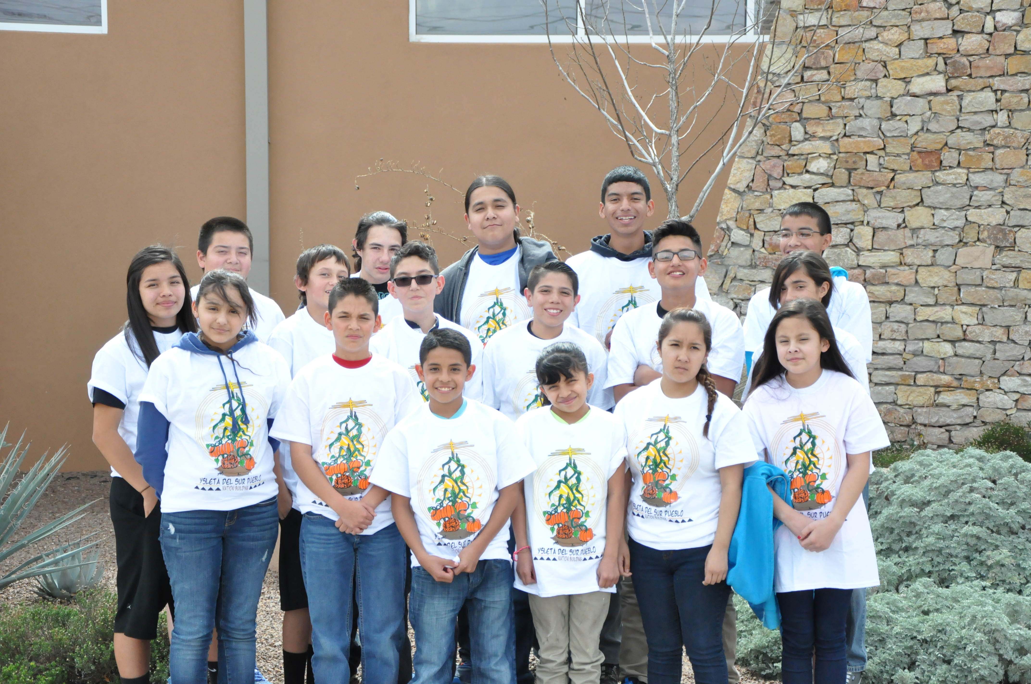

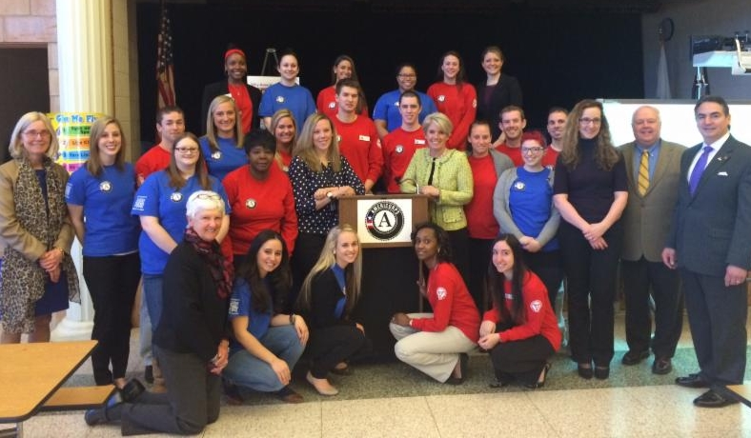
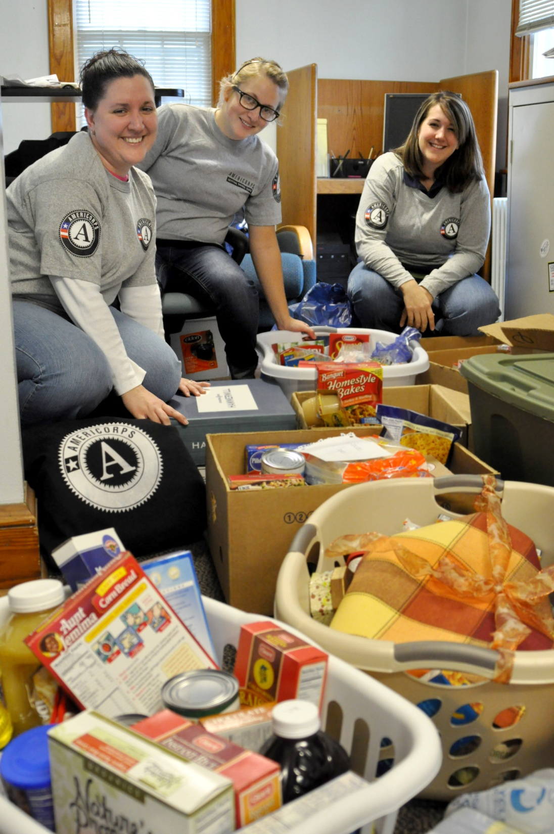
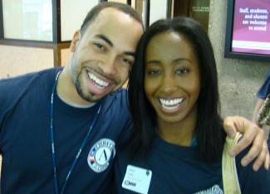
Thank You!
Notes:
Thank you!
Thank you for your participation in this orientation – and thank you very much for your service to your commission, state, and the national service community!

